Slide 1
AUTOMATED AMPLIFIER CIRCUIT
DESIGN GENERATION
BY:- SWAROOP PATIL

Slide 2
CONTENTS
Sl.no | TITLE
1 | PROBLEM STATEMENT & INTRODUCTION
2 | MOTIVATION & BACKGROUND
3 | LITERATURE SURVEY
4 | OBJECTIVES
5 | BLOCK DIAGRAM
6 | WORK FLOW
7 | RESULTS & CONCLUSION
8 | REFERENCES
2
AUTOMATED AMPLIFIER CIRCUIT DESIGN GENERATION

Slide 3

PROBLEM STATEMENT
Automated transistor level amplifier circuit design generation using VAE model.
3
AUTOMATED AMPLIFIER CIRCUIT DESIGN GENERATION

Slide 4

INTRODUCTION
Manual amplifier design is time-consuming and error-prone
Resistor selection (RC, RE, RG) is a key challenge
Automation can speed up and improve design accuracy
VAEs enable data-driven circuit generation
Project focuses on generating valid amplifier circuits using VAE
AUTOMATED AMPLIFIER CIRCUIT DESIGN GENERATION

Slide 5
MOTIVATION AND BACKGROUND
Manual resistor selection is time-consuming and prone to design errors.
There is a lack of scalable, intelligent tools for analog circuit automation.
Accurate analog design is critical but often bottlenecked by trial-and-error.
A data-driven solution like VAE can reduce human effort and speed up circuit development.
AUTOMATED AMPLIFIER CIRCUIT DESIGN GENERATION

Slide 6
BACKGROND:
Design Complexity: Amplifier circuits require precise resistor tuning (RC, RE, RG), making manual design time-consuming.
Traditional Methods: Rely on expert knowledge and trial-and-error, limiting scalability.
Modern Approaches: Use data-driven models to learn patterns from existing circuits.
Emerging Technologies: VAEs enable automated design by capturing and generating circuit structures.
Need for Automation: Speeds up development and reduces human error in analog circuit design.
AUTOMATED AMPLIFIER CIRCUIT DESIGN GENERATION

Slide 7
LITERATURE REVIEW
Paper Title | Year | Methodology | Limitations
Automated Framework for Level Shifter Circuit Design | 2022 | Autonomous topology generation and transistor sizing optimizing power and delay for level shifters | Focused only on level shifter circuits; may not generalize to other analog circuit types
Automation Framework for Digital Circuit Design and Verification | 2022 | Combines HLS with automated verification tools for digital circuit design and testing | Targets digital circuits only; lacks analog design automation and integration
LayoutCopilot: LLM-powered Multi-agent Framework for Analog Layout | 2025 | Multi-agent system using LLMs for interactive analog layout design with human-in-the-loop | Early-stage research; effectiveness depends on quality of LLM and collaboration mechanisms
AUTOMATED AMPLIFIER CIRCUIT DESIGN GENERATION

Slide 8

OBJECTIVES
Automate resistor selection in amplifier design.
Use VAE to learn and generate circuit designs.
Produce valid and functional amplifier circuits.
Evaluate designs with performance metrics.
Speed up and simplify analog circuit design.
AUTOMATED AMPLIFIER CIRCUIT DESIGN GENERATION

Slide 9
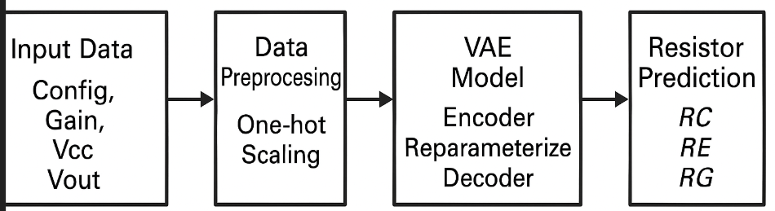
BLOCK DIAGRAM
AUTOMATED AMPLIFIER CIRCUIT DESIGN GENERATION

Slide 10
WORK FLOW
Data Collection: Gather a dataset of amplifier circuits with component values and topologies.
Preprocessing: Convert circuit data into a suitable format for the VAE model.
Model Training: Train the Variational Autoencoder to learn latent representations of the amplifier designs.
Decoder Reconstruction: Decode sampled latent vectors into amplifier circuit configurations.
Evaluation: Assess generated circuits using performance metrics (MSE, MAE, RMSE, R²) and functional validation.
Output: Select and output optimized amplifier circuit designs for further use or fabrication.
AUTOMATED AMPLIFIER CIRCUIT DESIGN GENERATION

Slide 11
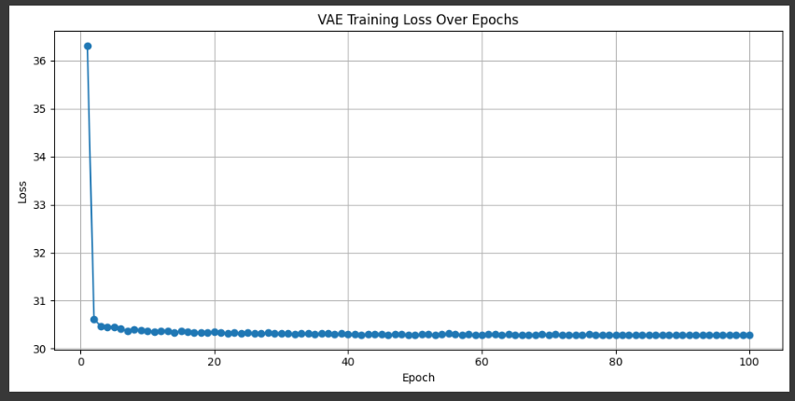
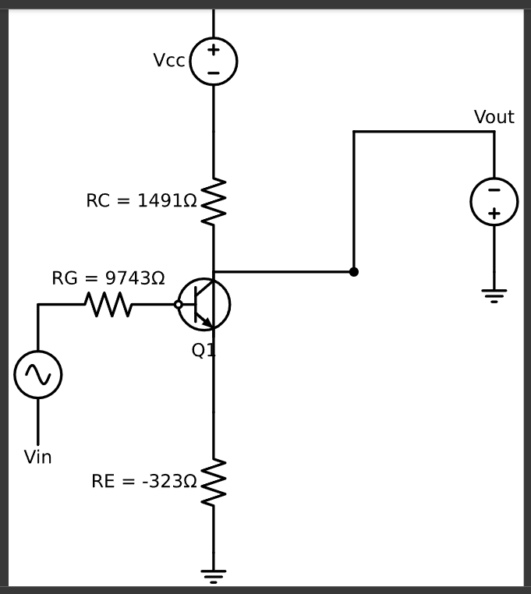
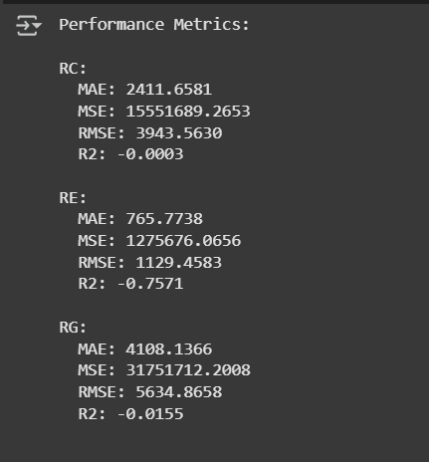
OUTPUTS
Fig(1)
Loss over epochs
Fig(2)
Generated amplifier circuit
Fig(3)
Performance matric
AUTOMATED AMPLIFIER CIRCUIT DESIGN GENERATION

Slide 12
RESULTS
Accurate Circuit Generation:
The VAE generated valid amplifier circuits from learned latent features.
Low Reconstruction Error:
Metrics like MSE, MAE, RMSE, and R² showed high accuracy in circuit reconstruction.
Design Diversity:
Latent space sampling produced varied yet functionally correct amplifier designs.
Effective Learning:
Loss curves showed consistent convergence, indicating successful training.
Clear Output:
Generated circuits retained logical structure and realistic resistor values (RC, RE, RG).
AUTOMATED AMPLIFIER CIRCUIT DESIGN GENERATION

Slide 13
CONCLUSION
Implemented a content-based book recommendation system.
Utilized TF-IDF to analyze book features (author and genre).
Measured similarity between books using cosine similarity.
Recommended books based on user input of author and genre.
Displayed the top 3 recommended books along with their similarity scores.
Visualized the similarity scores using a bar plot.
The system is efficient and can be extended with additional features for improved recommendations.
AUTOMATED AMPLIFIER CIRCUIT DESIGN GENERATION

Slide 14
REFERENCES
[1] Hong, Jiwoo Kim, Sunghoon Jeon, Dongsuk. (2022). An Automatic Circuit Design Framework for Level Shifter Circuits. IEEE Transactions on Computer-Aided Design of Integrated Circuits and Systems. PP. 1-1. 10.1109/TCAD.2022.3155444.
[2] H. Bong, K. Cho and Y. Seo, ”Automation Framework for Digital Circuit Design and Verification,” 2022 19th International SoC Design Conference (ISOCC), Gangneung-si, Korea, Republic of, 2022, pp. 263-264, doi: 10.1109/ISOCC56007.2022.10031431.
[3] B. Liu et al., ”LayoutCopilot: An LLM-Powered Multi-Agent Collaborative Framework for Interactive Analog Layout Design,” in IEEE Transactions on Computer-Aided Design of Integrated Circuits and Systems, doi: 10.1109/TCAD.2025.3529805.
[4] Z. Zhao, J. Luo, J. Liu and L. Zhang, ”Signal-Division-Aware Analog Circuit Topology Synthesis Aided by Transfer Learning,” in IEEE Transactions on Computer-Aided Design of Integrated Circuits and Systems, vol. 42, no. 11, pp. 3481-3490, Nov. 2023, doi: 10.1109/TCAD.2023.3245979.
[5]Bhandari, J., Bhat, V., He, Y., Garg, S., Rahmani, H. and Karri, R., 2024. Auto-SPICE: Leveraging LLMs for Dataset Creation via Automated SPICE Netlist Extraction from Analog Circuit Diagrams. arXiv preprint arXiv:2411.14299.
[6] Dong, Zehao, Weidong Cao, Muhan Zhang, Dacheng Tao, Yixin Chen, and Xuan Zhang ”CktGNN: Circuit graph neural network for electronic design automation.” arXiv preprintarXiv:2308.16406 (2023).
AUTOMATED AMPLIFIER CIRCUIT DESIGN GENERATION

